Slide 1
UniBot
The Frontier of Nano Technology

Slide 2


Slide 3
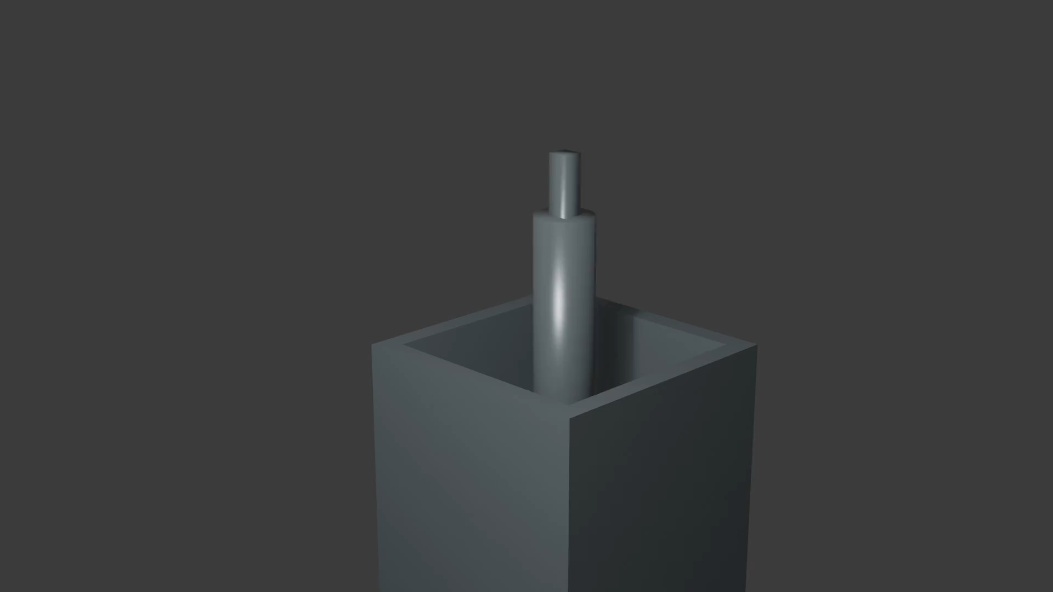

Slide 4
Applications
Transportation
Defence Sector
Construction
Industrial Automation

Slide 5
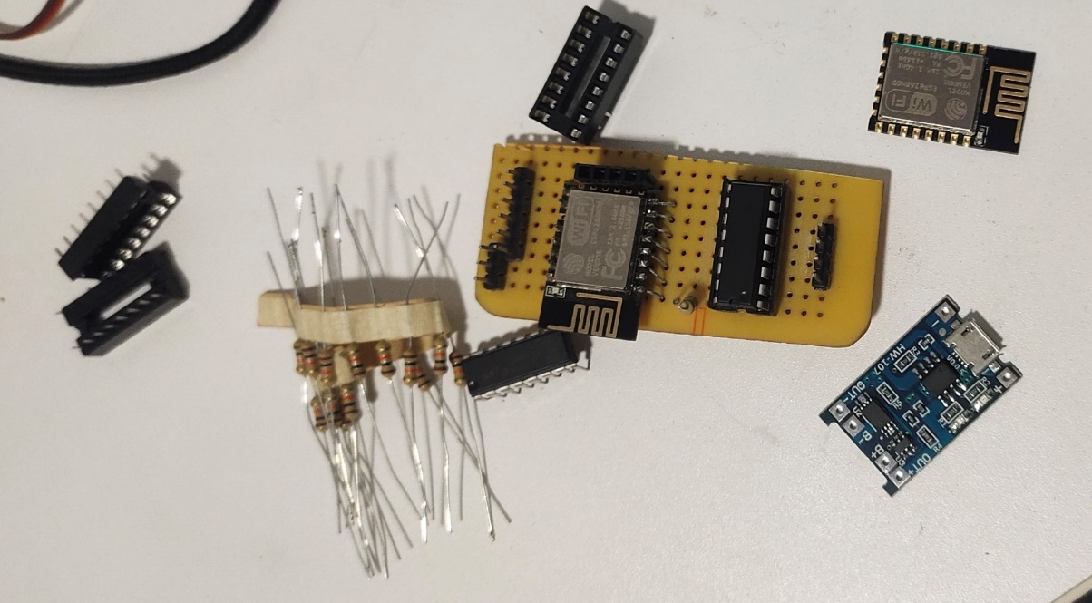
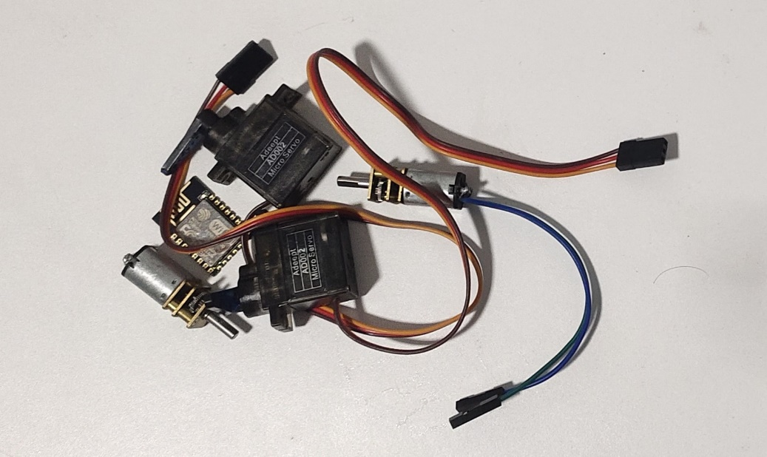
Hardware
ESP8266 Wi-Fi chip for ultra low power consumption.
AD002 Servo and N20 Gear motors controlled via L293D motor Driver

Slide 6
Hardware
Powered by lithium-ion battery
Completely handmade custom PCB for efficient signal routing optimal space usage and power management

Slide 7


Chip level Software
Features:
Compatible with all IoT platforms
Cloud Integration
Remote Diagnostics
Over-the-Air Code Update
ESP8266 Wi-Fi
MicroPython
Python

Slide 8


Master Software Backend
TCP Sockets
Master-Slave
Model
5-8 ms Latency
PyNput Library
Capture keystrokes from Keyboard
User-Friendly

Slide 9
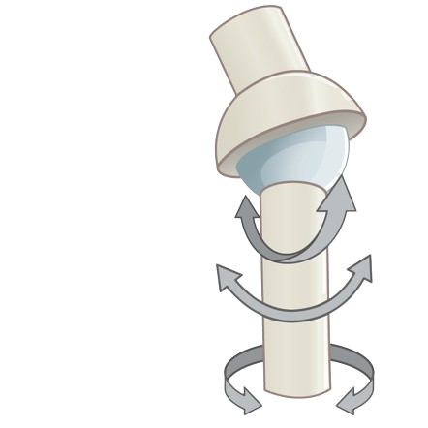
Prototyping of UniBot
Articulation
Using Ball and socket joint along with Electromagnets and magnets
Allows movements of Abduction, Adduction, Flexion, Extension, , rotation, circumduction
Precise and powerful

Slide 10
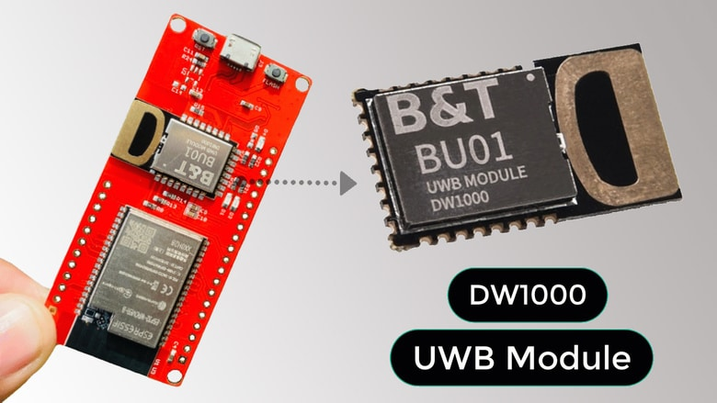
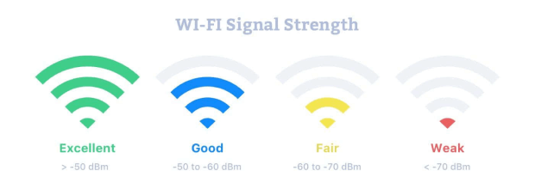
Prototyping of UniBot
3D Positioning System/Indoor Localization
Ultra-Wide-Band 3D positioning via Time-of-Flight concept
RSSI or Received Signal Strength Indicator

Slide 11
Demonstration

Slide 12
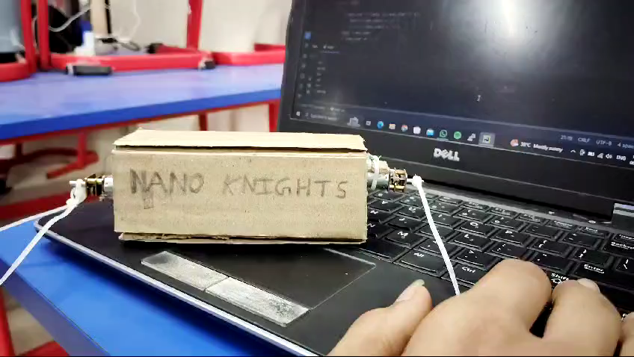

Slide 13
Thank You

